Slide 1
Attrition Measurement Update 2024
Continuing to Develop Meaningful Trends
Prepared By:
TRG Associates, Inc.
860-395-0548
www.trgassociates.com

Slide 2

Due Diligence
Acquisition Planning
Seeking Debt & Equity
Operations Analysis
Business Valuations
Expert Witness
Customer Surveys
Social Media Assessment

Slide 3
Defining Attrition
Gross Attrition
The loss of existing customers and their associated recurring monthly revenue (RMR) for contracted services during a particular customer/calendar cycle
Net Attrition
Gross Attrition plus the add back of “like customer” gains through resigns of the existing locations –
The Home/Business location is your ultimate customer
Price increases for inflation
Price increases for additional services or technology

Slide 4
Defining Attrition
The Short Version
The measurement of customer dissatisfaction with or need for the system.
Why Measure?
Attrition measures customer dissatisfaction which, for the most part, is company caused.
The Attrition tracking process should be managed to identify, focus on, and rectify those causes within each organization.

Slide 5
Attrition Measurement Methodology
Weighted Ending RMR Attrition Method:
Step 1: Cancelled RMR for the Reporting Period = Monthly Attrition Sum of Ending RMR for Each Month
Step 2: Monthly Attrition (from Step 1) * 12 = Annualized Attrition
An Excel Attrition Measurement Template is available on the TRG website with calculation formulas

Slide 6
Benefits of Weighted Ending RMR Method
Accounts for and weights RMR acquisitions
Accounts for timing of acquired RMR
Accounts for rapid internal growth and the timing thereof
Similar to many lending/equity institution’s preferred calculation

Slide 7
The Geography of Attrition
NE/Mid Atlantic
Southeast
Midwest
Southwest
West
International

Slide 8
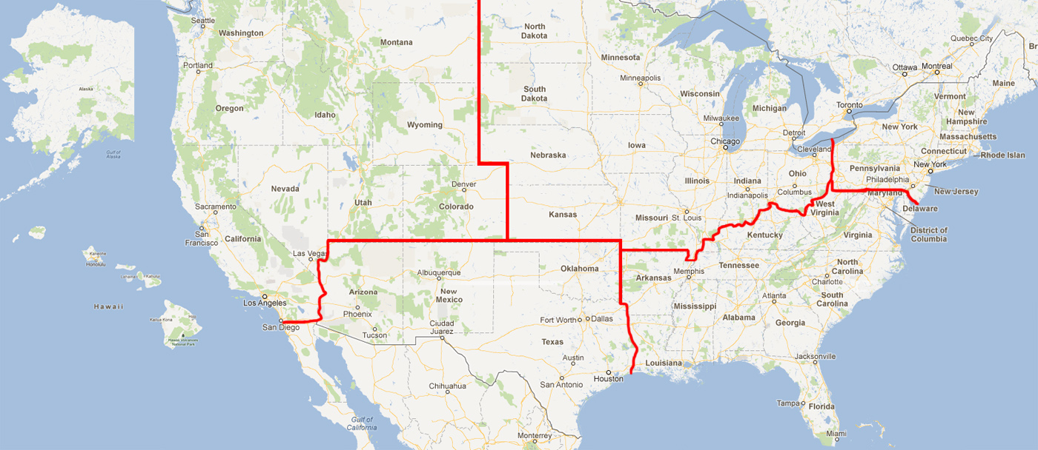

Slide 9
Attrition Update Through Year End 2024
 | 2022 |  | 2023 |  | 2024
Region | Gross | Net | Gross | Net | Gross | Net
Northeast | 12.52% | 10.27% | 11.35% | 9.89% | 11.28% | 10.14%
Southeast | 13.27% | 10.92% | 12.87% | 11.78% | 13.06% | 12.27%
Midwest | 14.02% | 11.67% | 13.48% | 11.83% | 11.70% | 10.60%
Southwest | 13.69% | 11.50% | 13.64% | 12.36% | 13.68% | 12.79%
West | 13.62% | 11.08% | 12.18% | 10.56% | 11.72% | 10.20%
International | 12.61% | 10.42% | 12.18% | 9.01% | 11.50% | 8.34%

Slide 10
Attrition Update Through Year End 2024
 | 2022 |  | 2023 |  | 2024
Company Size | Gross | Net | Gross | Net | Gross | Net
3-50 | 5.61% | 4.98% | 9.85% | 8.66% | 9.18% | 8.40%
51-100 | 7.59% | 6.57% | 9.25% | 8.27% | 9.34% | 8.39%
101-200 | 9.84% | 8.22% | 12.27% | 11.33% | 12.39% | 11.43%
201-500 | 11.61% | 9.83% | 12.08% | 11.14% | 12.61% | 11.71%
500+ | 13.67% | 11.26% | 13.16% | 11.64% | 12.97% | 11.74%

Slide 11
Net Attrition by Company Size 10 Year Profile

Slide 12
Attrition Comparison 500+ Company Size 2010/2022/2023/2024
 | 2010 |  | 2022 |  | 2023 |  | 2024
Company Size | Gross | Net | Gross | Net | Gross | Net | Gross | Net
500+ | 11.41% | 8.68% | 13.67% | 11.26% | 13.16% | 11.64% | 12.97% | 11.74%
RMR | $137,082,802 |  | $769,915,742 |  | $835,937,951 | 769,915,742 | $553,058,637 | 769,915,742

Slide 13
Attrition Update Through Year End 2024
 | 2022 |  | 2023 |  | 2024
Source | Gross | Net | Gross | Net | Gross | Net
Dealer | 15.31% | 13.02% | 14.33% | 12.37% | 13.13% | 10.65%
Traditional | 12.74% | 10.54% | 12.84% | 11.25% | 12.95% | 11.39%
Mass Market | 13.97% | 11.32% | 13.15% | 10.92% | 12.07% | 9.56%

Slide 14
Net Attrition by Origination Source 10 Year Profile

Slide 15
Attrition Update Through Year End 2024
 | 2022 |  | 2023 |  | 2024
Customer Type | Gross | Net | Gross | Net | Gross | Net
Residential | 14.09% | 11.76% | 13.56% | 12.30% | 13.23% | 12.53%
Commercial | 11.44% | 9.07% | 11.81% | 9.77% | 12.20% | 10.05%

Slide 16
Residential vs. Commercial 10 Year Profile

Slide 17
An Illustration of Resilience

Slide 18
Reason Code Analysis
Cancellation Reason | 2022 | 2023 | 2024
Collection/Non-Payment | 11.68% | 12.95% | 19.35%
Moved | 40.08% | 36.45% | 34.20%
Poor Service | 3.21% | 3.17% | 4.12%
Lost to Competition | 12.29% | 11.82% | 7.39%
No Longer Using System | 14.30% | 13.86% | 13.57%
Sold/Out of Business | 9.43% | 9.99% | 7.98%
Financial Difficulties | 4.14% | 5.83% | 6.88%
Property Abandoned/Vacant | 0.07% | 0.12% | 0.08%
End of Contract Term | 0.46% | 0.61% | 0.91%
Deceased/Rest home | 0.88% | 0.88% | 0.20%
PI Rescinded/RMR Reduction | 2.23% | 4.23% | 5.32%
2G/3G/4G Transition | 1.22% | 0.09% | 0.00%

Slide 19
Top Reasons for Attrition

Slide 20
Net Attrition by Reason Code Top 5 Reasons

Slide 21
PERS Attrition

Slide 22
PERS Attrition Profile
Attrition Profile Comparative - Overall
 | 2022 | 2023 | 2024
Data Population | 2,802,000 Subscribers | 2,249,000 Subscribers | 5,900,000 Subscribers
Estimated RMR | $89.5M | $72.9M | $194.0M
Annualized Attrition | 30.6% | 31.4% | 30.0%
Monthly Average Attrition | 2.55% | 2.61% | 2.50%
Sources: Published Attrition metrics, company and PERS Central Station interviews and PERS transaction presentations/analysis.
LEK/CHS 2025 PERS Annual Industry Outlook. See Connected Health & Safety Association (MAMA) chsassociation.org

Slide 23
PERS DTC Attrition Reasons Comparison
*
* Sources: LEK/CHS 2025 PERS Annual Industry Outlook. See Connected Health & Safety Association (MAMA) chsassociation.org

Slide 24
Attrition Best Practices Gathering

Slide 25
Attrition Analytics
Provides data and focus:
By Branch
Service Issues
Central Station Issues
By Product Utilization Issues
Attrition Predictive Analytics
Analysis of Customer Touches - Email, Phone Contacts, Payment History, Signal Activity
Complaints Analysis and NPS Score
Assign Values to Customer Characteristics and Weight Each
Arrive at an Attrition Predictive Index (API)
Develop a Corrective Action plan by API Index
Cancel Pending
Probable Cancel Pending
Watch List

Slide 26
TRG Maintains Full Confidentiality of Participant’s Figures
Summary results as presented will be available on
TMA Website: https://tma.us
TRG Website: www.trgassociates.com
CHS Website: www.chsassociation.org

Slide 27
Thank you
Please contact John Brady at jbrady@trgassociates.com
with any questions

