Slide 1
Attrition Measurement Update 2023
Continuing to Develop Meaningful Trends
Prepared By:
TRG Associates, Inc.
860-395-0548
www.trgassociates.com

Slide 2

Due Diligence
Acquisition Planning
Seeking Debt & Equity
Operations Analysis
Business Valuations
Expert Witness
Customer Surveys
Social Media Assessment

Slide 3
Defining Attrition
Gross Attrition
The loss of existing customers and their associated recurring monthly revenue (RMR) for contracted services during a particular customer/ calendar cycle
Net Attrition
Gross Attrition plus the add back of “like customer” gains thru resigns of the existing locations –
The Home/Business location is your ultimate customer
Price increases for inflation
Price increases for additional services or technology

Slide 4
Defining Attrition
The Short Version
The measurement of customer dissatisfaction with or need for the system
Why Measure?
Attrition measures customer dissatisfaction which, for the most part, is company caused.
The Attrition Tracking Process should be managed to identify, focus on, and rectify those causes within each organization.

Slide 5
Attrition Measurement Methodology
Weighted Ending RMR Attrition Method
Step 1: Cancelled RMR for the Reporting Period = Monthly Attrition Sum of Ending RMR for Each Month
Step 2: Monthly Attrition (from Step 1)* 12 = Annualized Attrition
An Excel Attrition Measurement Template is available on the TRG website with calculation formulas

Slide 6
Benefits of Weighted Ending RMR Method
Accounts for and weights RMR acquisitions
Accounts for timing of acquired RMR
Accounts for rapid internal growth and the timing thereof
Similar to many lending/equity institution’s preferred calculation.

Slide 7
The Geography of Attrition
NE/Mid Atlantic
Southeast
Midwest
Southwest
West
International

Slide 8
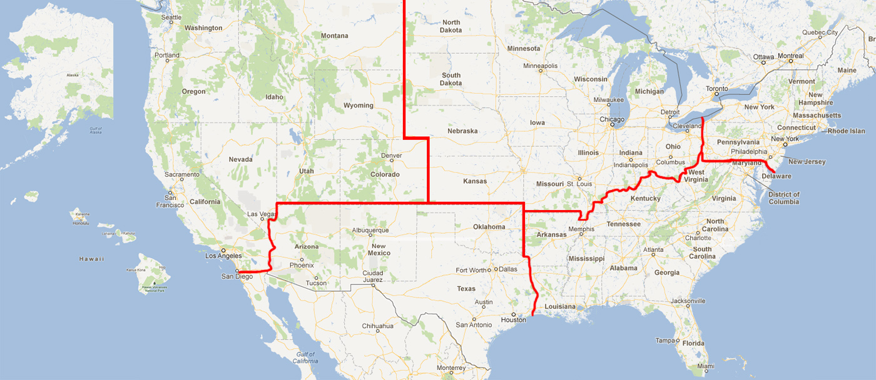

Slide 9
Annual Trend Dollars of RMR*
Region |  | 2021 |  | 2022 |  | 2023
Northeast | $ | 123,111,156 | $ | 125,700,362 | $ | 140,510,754
Southeast | $ | 224,956,229 | $ | 248,337,308 | $ | 256,458,003
Midwest | $ | 129,069,346 | $ | 165,835,105 | $ | 148,340,730
Southwest | $ | 110,997,455 | $ | 109,359,971 | $ | 128,454,758
West | $ | 153,938,732 | $ | 142,491,815 | $ | 174,004,194
International | $ | 42,050,549 | $ | 52,017,838 | $ | 53,052,081
Total | $ | 784,123,467 | $ | 843,742,400 | $ | 900,820,520
*Recurring Monthly Revenue

Slide 10
Annual Trend Dollars of RMR*
Size |  | 2021 |  | 2022 |  | 2023
3-50 | $ | 280,051 | $ | 4,628,258 | $ | 3,690,649
51-100 | $ | 1,491,048 | $ | 8,756,493 | $ | 7,023,135
101-200 | $ | 5,519,824 | $ | 20,150,682 | $ | 19,101,697
201-500 | $ | 23,991,954 | $ | 40,291,225 | $ | 35,067,088
500+ | $ | 752,840,591 | $ | 769,915,742 | $ | 835,937,951
Total | $ | 784,123,467 | $ | 843,742,400 | $ | 900,820,520
*Includes branches of companies reflected by RMR size/Attrition if provided

Slide 11
Annual Trend Dollars of RMR
Customer Source |  | 2021 |  | 2022 |  | 2023
Dealer | $ | 198,822,624 | $ | 91,908,172 | $ | 71,491,648
Traditional | $ | 237,422,728 | $ | 505,837,681 | $ | 566,032,164
Mass Market | $ | 347,878,115 | $ | 245,996,547 | $ | 263,296,707
Total | $ | 784,123,467 | $ | 843,742,400 | $ | 900,820,520

Slide 12
Annual Trend Dollars of RMR
Customer Type |  | 2021 |  | 2022 |  | 2023
Residential | $ | 572,848,961 | $ | 616,703,141 | $ | 640,451,769
Commercial | $ | 211,274,506 | $ | 227,039,259 | $ | 260,368,751
Total | $ | 784,123,467 | $ | 843,742,400 | $ | 900,820,520

Slide 13
Attrition Update through Year End 2023
 | 2021 |  | 2022 |  | 2023
Region | Gross | Net | Gross | Net | Gross | Net
Northeast | 14.16% | 12.65% | 12.52% | 10.27% | 11.35% | 9.89%
Southeast | 13.67% | 12.39% | 13.27% | 10.92% | 12.87% | 11.78%
Midwest | 12.51% | 11.05% | 14.02% | 11.67% | 13.48% | 11.83%
Southwest | 13.82% | 12.34% | 13.69% | 11.50% | 13.64% | 12.36%
West | 13.03% | 11.44% | 13.62% | 11.08% | 12.18% | 10.56%
International | 12.89% | 11.02% | 12.61% | 10.42% | 12.18% | 9.01%

Slide 14
Attrition Update through Year End 2023
 | 2021 |  | 2022 |  | 2023
Co. Size | Gross | Net | Gross | Net | Gross | Net
3-50 | 14.60% | 13.27% | 5.61% | 4.98% | 9.85% | 8.66%
51-100 | 8.41% | 7.09% | 7.59% | 6.57% | 9.25% | 8.27%
101-200 | 10.20% | 9.74% | 9.84% | 8.22% | 12.27% | 11.33%
201-500 | 9.40% | 8.34% | 11.61% | 9.83% | 12.08% | 11.14%
500+ | 13.57% | 12.10% | 13.67% | 11.26% | 13.16% | 11.64%

Slide 15
Net Attrition by Company Size 10 Year Profile

Slide 16
Attrition Update through Year End 2023
 | 2021 |  | 2022 |  | 2023
Source | Gross | Net | Gross | Net | Gross | Net
Dealer | 15.35% | 14.33% | 15.31% | 13.02% | 14.33% | 12.37%
Traditional | 11.47% | 9.87% | 12.74% | 10.54% | 12.84% | 11.25%
Mass Market | 14.20% | 12.57% | 13.97% | 11.32% | 13.15% | 10.92%

Slide 17
Net Attrition by Origination Source 10 Year Profile

Slide 18
Attrition Update through Year End 2023
 | 2021 |  | 2022 |  | 2023
Customer Type | Gross | Net | Gross | Net | Gross | Net
Residential | 14.40% | 12.95% | 14.09% | 11.76% | 13.56% | 12.30%
Commercial | 11.55% | 10.02% | 11.44% | 9.07% | 11.81% | 9.77%

Slide 19
Residential vs. Commercial
10 Year Profile

Slide 20
Reason Code Analysis
Cancellation Reason | 2020 | 2021 | 2022 | 2023
Collection/Non-Payment | 10.60% | 12.34% | 11.68% | 12.95%
Moved | 33.77% | 40.57% | 40.08% | 36.45%
Poor Service | 2.67% | 3.58% | 3.21% | 3.17%
Lost to Competition | 17.80% | 11.36% | 12.29% | 11.82%
No Longer Using System | 12.84% | 14.97% | 14.30% | 13.86%
Sold/Out of Business | 9.03% | 7.11% | 9.43% | 9.99%
Financial Difficulties | 5.63% | 4.85% | 4.14% | 5.83%
Property Abandoned/Vacant | 0.40% | 0.04% | 0.07% | 0.12%
End of Contract Term | 0.72% | 0.42% | 0.46% | 0.61%
Deceased/Rest home | 0.91% | 0.93% | 0.88% | 0.88%
PI Rescinded/RMR Reduction | 4.55% | 2.12% | 2.23% | 4.23%
2G/3G/4G Transition | 0.74% | 1.71% | 1.22% | 0.09%

Slide 21
Top Reasons for Attrition

Slide 22
Net Attrition by Reason Code - Top 5 Reasons

Slide 23
Attrition Comparison 500+ Co Size 2010/21/22/23
 | 2010 |  | 2021 |  | 2022 |  | 2023
Co. Size | Gross | Net | Gross | Net | Gross | Net | Gross | Net
500+ | 11.41% | 8.68% | 13.57% | 12.1% | 13.67% | 11.26% | 13.16% | 11.64%
RMR | $137,082,802 |  | $752,840,591 |  | $769,915,742 | 769,915,742 | $835,937,951 | 769,915,742

Slide 24
PERS Attrition

Slide 25
PERS Attrition Profile
Attrition Profile Comparative
 | 2021 | 2022 | 2023
Data Population | 1,947,500 Subscribers | 2,802,000 Subscribers | 2,249,000 Subscribers
Estimated RMR | $51.2M | $89.5M | $72.9M
Annualized Attrition | 29.90% | 30.6% | 31.4%
Monthly Average Attrition | 2.49% | 2.55% | 2.61%
Sources: Published Attrition metrics, company and PERS Central Station interviews and PERS transaction presentations/analysis.

Slide 26
PERS Attrition Reasons Comparison

Slide 27
Attrition Best Practices Gathering

Slide 28
Attrition Analytics
Provides data and focus:
By Branch
Service Issues
Central Station Issues
By Product Utilization Issues
Attrition Predictive Analytics
Analysis of Customer Touches - Email, Phone Contacts, Payment history, Signal activity
Complaint's analysis and NPS score
Assign values to customer characteristics and weight each
Arrive at an Attrition Predictive Index (API)
Develop a Corrective Action plan by API Index
Cancel Pending
Probable Cancel Pending
Watch List

Slide 29
TRG Maintains Full Confidentiality of Participant’s Figures
Summary results as presented will be available on
TMA Web-Site (www.tma.us)
TRG Web-Site (www.trgassociates.com)
Next update for 2024 – August 2025
Posted in September 2025

Slide 30
Questions & Answers
Please contact John Brady at jbrady@trgassociates.com with any questions

