Slide 1
Attrition Measurement Update 2016
Continuing to Develop Meaningful Trends
Prepared By:
TRG Associates, Inc.
860-395-0548
www.trgassociates.com

Slide 2


Slide 3
Defining Attrition
Gross Attrition
The loss of existing customers and their associated recurring monthly revenue (RMR) for contracted services during a particular customer / calendar cycle
Net Attrition
Gross Attrition plus the add back of “like customer” gains thru resigns of the existing locations –
- The Home/Business location is your ultimate customer
- Price increases for inflation
- Price increases for additional services or technology

Slide 4
Defining Attrition
The Short Version
The measurement of customer dissatisfaction with or need for the system
Why Measure?
Attrition measures customer dissatisfaction which, for the most part, is company caused.
The Attrition Tracking Process should be managed to identify, focus on, and rectify those causes within each organization.

Slide 5
Attrition Measurement Methodology
Weighted Ending RMR Attrition Method
Step 1: Cancelled RMR for the Reporting Period = Monthly Attrition Sum of Ending RMR for Each Month
Step 2: Monthly Attrition (from Step 1)* 12 = Annualized Attrition
An Excel Attrition Measurement Template is available on
the TRG website with calculation formulas

Slide 6
Benefits of Weighted Ending RMR Method
Accounts for and weights RMR acquisitions
Accounts for timing of acquired RMR
Accounts for rapid internal growth and the timing thereof
Similar to many lending/equity institution’s preferred calculation.

Slide 7
The Geography of Attrition
NE/Mid Atlantic
Southeast
Midwest
Southwest
West
International

Slide 8
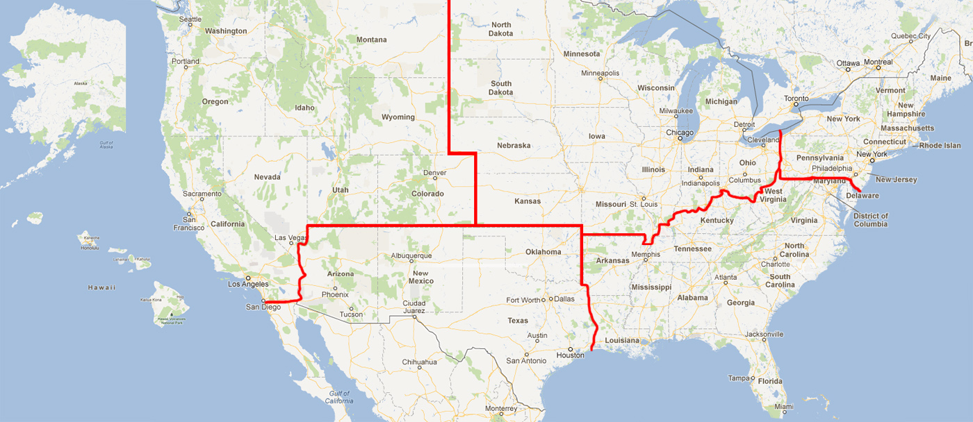

Slide 9
Annual Trend Dollars of RMR*
Region |  | 2014 |  | 2015 |  | 2016
Northeast | $ | 54,887,157 | $ | 54,531,186 | $ | 57,297,528
Southeast | $ | 64,227,355 | $ | 64,136,881 | $ | 71,595,895
Midwest | $ | 56,701,756 | $ | 52,941,995 | $ | 58,074,794
Southwest | $ | 37,898,804 | $ | 38,126,266 | $ | 46,047,519
West | $ | 64,987,225 | $ | 64,141,912 | $ | 70,346,795
International | $ | 28,529,938 | $ | 24,462,876 | $ | 28,284,374
 | $ | 307,232,235 | $ | 298,341,118 | $ | 331,646,905
*Recurring Monthly Revenue

Slide 10
Annual Trend Dollars of RMR*
Size |  | 2014 |  | 2015 |  | 2016
3-50 | $ | 232,868 | $ | 284,067 | $ | 160,224
51-100 | $ | 652,509 | $ | 1,029,517 | $ | 830,403
101-200 | $ | 1,290,972 | $ | 2,189,042 | $ | 2,099,217
201-500 | $ | 14,941,619 | $ | 15,147,786 | $ | 15,873,539
500+ | $ | 290,114,267 | $ | 279,690,706 | $ | 312,683,522
Total | $ | 307,232,235 | $ | 298,341,118 | $ | 331,646,905
*Includes branches of companies reflected by RMR size/Attrition if provided

Slide 11
Annual Trend Dollars of RMR
Customer Source |  | 2014 |  | 2015 |  | 2016
Dealer | $ | 70,467,388 | $ | 65,880,451 | $ | 67,500,074
Traditional | $ | 137,992,667 | $ | 132,670,100 | $ | 145,013,567
Mass Market | $ | 98,772,181 | $ | 99,790,568 | $ | 119,133,264
Total | $ | 307,232,235 | $ | 298,341,118 | $ | 331,646,905

Slide 12
Annual Trend Dollars of RMR
Customer Type |  | 2014 |  | 2015 |  | 2016
Residential | $ | 176,598,078 | $ | 171,099,682 | $ | 200,515,508
Commercial | $ | 130,634,158 | $ | 127,241,436 | $ | 131,131,397
Total | $ | 307,232,235 | $ | 298,341,118 | $ | 331,646,905

Slide 13
Attrition Update through Year End 2016
 | 2014 |  | 2015 |  | 2016
Region | Gross | Net | Gross | Net | Gross | Net
Northeast | 11.12% | 9.15% | 11.74% | 9.74% | 12.19% | 10.43%
Southeast | 12.49% | 10.64% | 12.84% | 10.85% | 12.91% | 10.92%
Midwest | 12.44% | 10.86% | 11.72% | 10.15% | 12.29% | 10.70%
Southwest | 13.51% | 11.99% | 13.60% | 11.98% | 14.39% | 12.65%
West | 12.26% | 10.12% | 12.27% | 10.10% | 12.64% | 10.39%
International | 12.15% | 10.42% | 13.57% | 12.09% | 13.90% | 12.18%

Slide 14
Attrition Update through Year End 2016
 | 2014 |  | 2015 |  | 2016
Co. Size | Gross | Net | Gross | Net | Gross | Net
3-50 | 7.10% | 6.09% | 6.55% | 5.83% | 8.32% | 7.64%
51-100 | 7.97% | 6.06% | 6.16% | 4.88% | 9.43% | 7.44%
101-200 | 9.46% | 8.02% | 9.17% | 8.21% | 9.18% | 7.90%
201-500 | 9.32% | 7.90% | 9.57% | 8.10% | 10.66% | 8.93%
500+ | 12.46% | 10.61% | 12.68% | 10.79% | 13.06% | 11.17%

Slide 15
Net Attrition by Company Size10 Year Profile

Slide 16
Attrition Update through Year End 2016
 | 2014 |  | 2015 |  | 2016
Source | Gross | Net | Gross | Net | Gross | Net
Dealer | 12.59% | 10.91% | 12.95% | 11.29% | 12.99% | 11.66%
Traditional | 11.86% | 9.86% | 11.62% | 9.56% | 11.96% | 9.96%
Mass Market | 12.66% | 10.94% | 13.30% | 11.55% | 14.01% | 11.98%

Slide 17
Net Attrition by Origination Source10 Year Profile

Slide 18
Attrition Update through Year End 2016
 | 2014 |  | 2015 |  | 2016
Customer Type | Gross | Net | Gross | Net | Gross | Net
Residential | 12.42% | 10.60% | 12.90% | 11.03% | 13.40% | 11.50%
Commercial | 12.10% | 10.25% | 11.89% | 10.05% | 12.15% | 10.32%

Slide 19
Residential vs. Commercial 10 Year Profile

Slide 20
Impact on Attrition Measurement with TWO Largest Company Results (TLC)
 | Excluding TLC |  | Including TLC
 | 2015 | 2016 | 2015 | 2016
501+ RMR Companies | $279.7M | $312.9M | $642.5M | $747.6M
Net Attrition
Company Size | 10.79% | 11.17% | 11.93% | 12.08%
Residential | 11.03% | 11.50% | 12.34% | 12.29%
Commercial | 10.05% | 10.32% | 10.71% | 11.40%
Sources: SDM May 2017 – SDM 100
SEC Filings 10K
Public Quarterly Company Review
Research Company Data

Slide 21
Net Attrition Inclusive of TLC

Slide 22
Top Reasons for Attrition

Slide 23
Reason Code Analysis
Cancellation Reason | 2013 | 2014 | 2015 | 2016
Collection/Non Payment | 16.1% | 15.1% | 15.1% | 14.8%
Moved | 35.6% | 35.2% | 33.6% | 32.5%
Poor Service | 3.3% | 3.5% | 3.4% | 3.3%
Lost to Competition | 14.3% | 16.3% | 16.0% | 14.9%
No Longer Using System | 10.4% | 10.7% | 10.8% | 12.0%
Sold/Out of Business | 3.1% | 3.7% | 4.7% | 4.3%
Financial Difficulties | 9.3% | 7.9% | 7.9% | 8.7%
Property Abandoned/Vacant | 0.1% | 0.1% | 0.1% | 0.1%
End of Contract Term | 0.7% | 0.2% | 0.8% | 0.4%
Deceased/Rest home | 0.5% | 0.4% | 0.4% | 0.5%
PI Rescinded/RMR Reduction | 6.6% | 6.9% | 7.1% | 8.5%

Slide 24
Net Attrition by Reason Code Top 5 Reasons

Slide 25
TRG Maintains Full Confidentiality of Participant’s Figures
Summary results as presented will be available on
TMA Web-Site (www.tma.us)
TRG Web-Site (www.trgassociates.com)
Next update for 2017 – August 2018 Posted in September 2018

